Slide 1
Table of Contents
BACKGROUND
PROBLEM STATEMENT
CONSTRAINTS
SCOPE DEFINITION
GOALS OF THE PROJECT
OPPORTUNITIES TO IMPROVE
SCHEDULE
BUDGET
INTERNAL RESOURCES

Slide 2
1. BACKGROUND
1. BACKGROUND
A local library called SMRT is a non-profit library funded by its local community. The library gives the community access to a large collection of books from around the world for very little fees, allowing everyone to better their knowledge and reading skills. Members from the community come daily to rent out or return the books. Special events are also organized for the community where they can come to the library for free and listen to a reader.

Slide 3
2. PROBLEM STATEMENT
The current information system is still maintained manually. This presents a variety of problems for the local library:
Inefficiency due to the nature of the manual processes being time consuming as well as labour intensive.
No reporting system is currently in place, making it hard to predict future outcomes for the library.
Data management is difficult and involves a lot of manual labour, making the risk of mistakes passing through a lot higher.
The information system currently in use is outdated and no longer able to keep up with the business requirements. The following processes are not automated:
Fees on overdue books
Reading events being booked
Inventory Control

Slide 4
3. CONSTRAINTS
Constraints include a budget of R513 014 as the library decided to invest in a simple information system.
As a result of this budget the system will be designed and written using Visual Studio with an Access or Server-Based Database.
Due to integration issues the LMS will have to be used on independent terminals.
The Library Management System (LMS) must be implemented ahead of the busy season by November 2025.

Slide 5
4. SCOPE DEFINITION
Maintain Books
Maintain Members
Maintain Events
Maintain Readers
Process loans
Process returns
Request reports
Project will not integrate with other library systems

Slide 6
5. GOALS OF THE PROJECT
The system must help improve the business knowledge by incorporating a reporting system that allows for management to see and manipulate data.
The system must help improve the business processes by automating certain processes like fees and inventory management, as well as create a more efficient workflow by having all business processes on one system.
The system must help improve business communication by providing the user with a consistent and understandable graphical user interface, a help function as well as an easy to use format.

Slide 7
6. OPPORTUNITIES TO IMPROVE
The LMS presents several opportunities to improve the library’s services and operations:
Enhanced User Experience: Patrons will be able to easily search the catalog, check book availability, and manage their accounts online, improving their overall experience.
Data-Driven Decision Making: The library will be able to generate reports on key metrics, enabling them to make informed decisions about collection development, resource allocation, and service improvements.

Slide 8
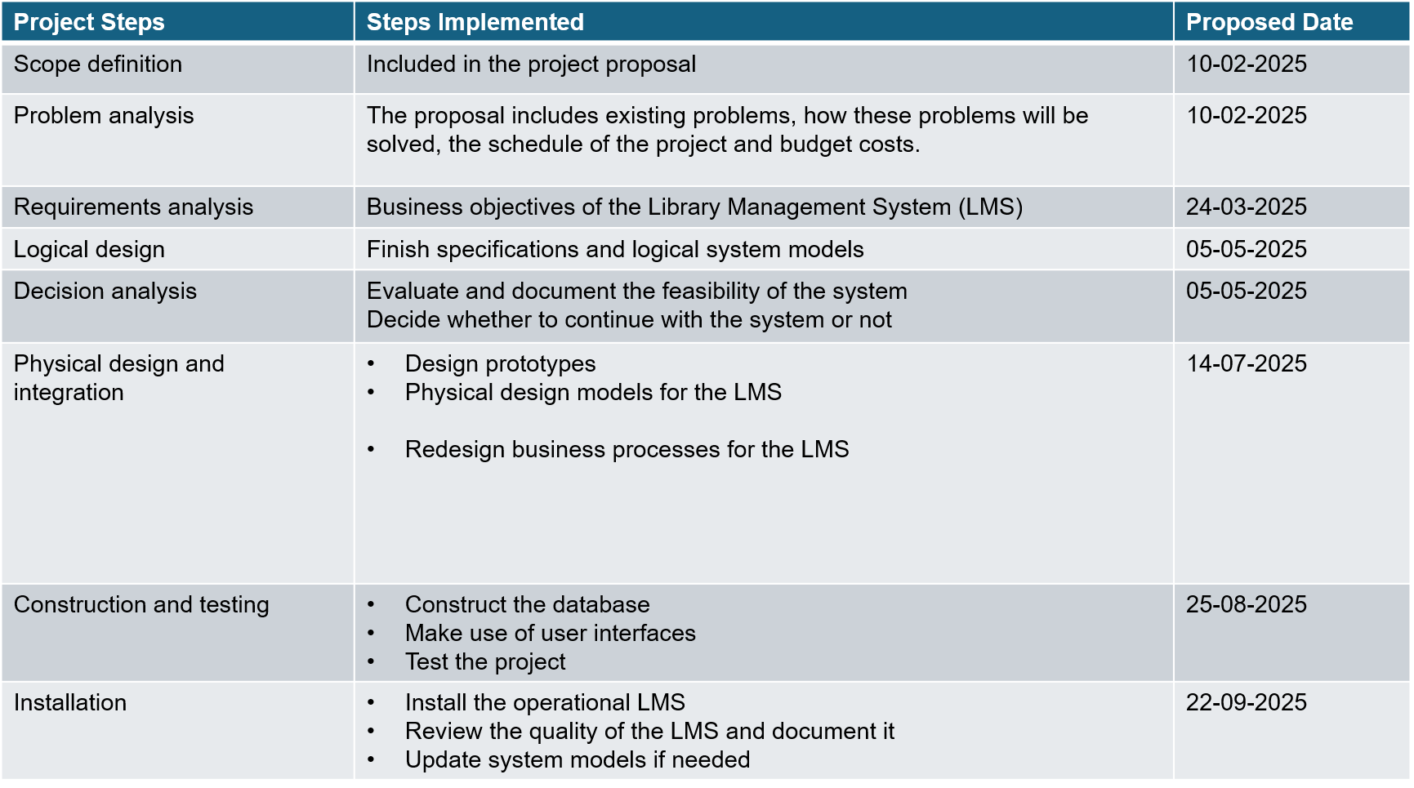
7. SCHEDULE OF PROJECT

Slide 9
8. BUDGET
MAN-HOUR:
Internal Cost: = 20% of 2 people working 8 hours a day for 6 months @ R30/hour
= 0.2(2 x 8 x 22.5 x 6 x 30)
= R12 960
Consultant Cost: =3 people working 4 hours a day for 6 months @ R305/hour
= 3 x 4 x 22.5 x 6 x 305
= R494 100

Slide 10
8. BUDGET (CONTINUED)
HARDWARE:
Personal Computer with Windows Operating system : R5000
SOFTWARE:
Microsoft Excel at R159/month
= 159 x 6 = R954
TOTAL COST: = R954 + R5000 + R494 100 + R12 960
= R513 014
MONTHLY ONGOING COST OF: R159

Slide 11
9. INTERNAL RESOURCES
Proposed internal resources for the project are:
System owner (Sponsor): Director and Chief Curator, Mrs Linda Redelinghuys
The proposed system users listed below are available to dedicate 25% of their time over the next 8 months:
Rowen Wentzel
Mihla Xoko
Josh Taylor

